Slide 1

Neural Networks
PhD. Msc. David C. Baldears S.
PhD(s) Msc. Diego Lopez-Bernal

Slide 2
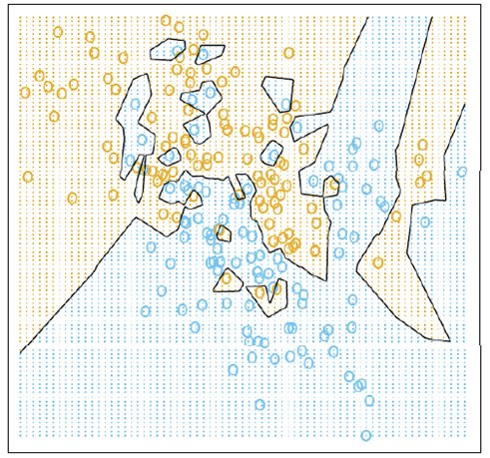
Representational Power
NNs with at least one hidden layer are universal approximators
Given any continuous function h(x) and some 𝜖>0, there exists a NN with one hidden layer (and with a reasonable choice of non-linearity) described with the function f(x), such that ∀𝑥, |ℎ(𝑥)−𝑓(𝑥)|<𝜖
i.e., NN can approximate any arbitrary complex continuous function
NNs use nonlinear mapping of the inputs x to the outputs f(x) to compute complex decision boundaries
But then, why use deeper NNs?
The fact that deep NNs work better is an empirical observation
Mathematically, deep NNs have the same representational power as a one-layer NN

Slide 3
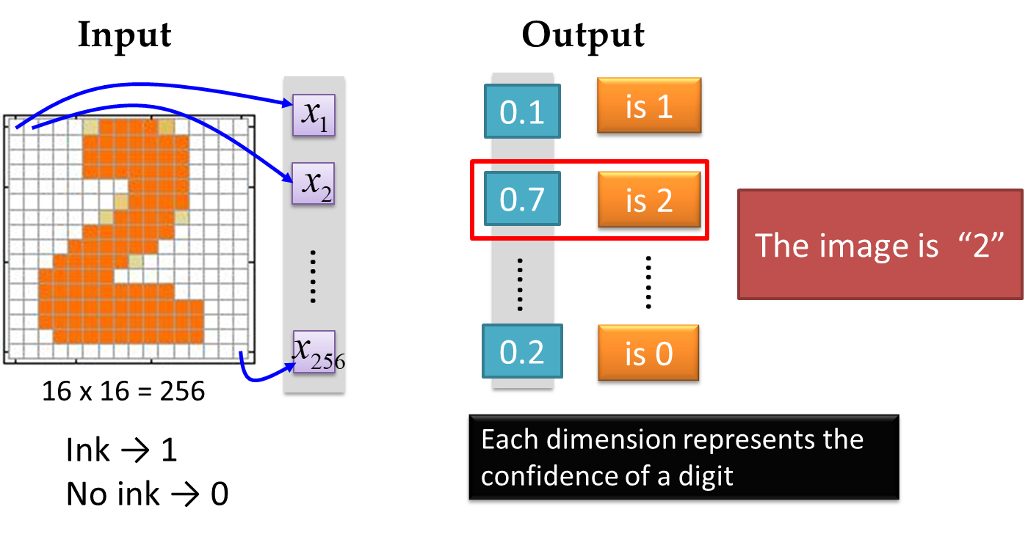
Neural Networks
Handwritten digit recognition (MNIST dataset)
The intensity of each pixel is considered an input element
Output is the class of the digit

Slide 4
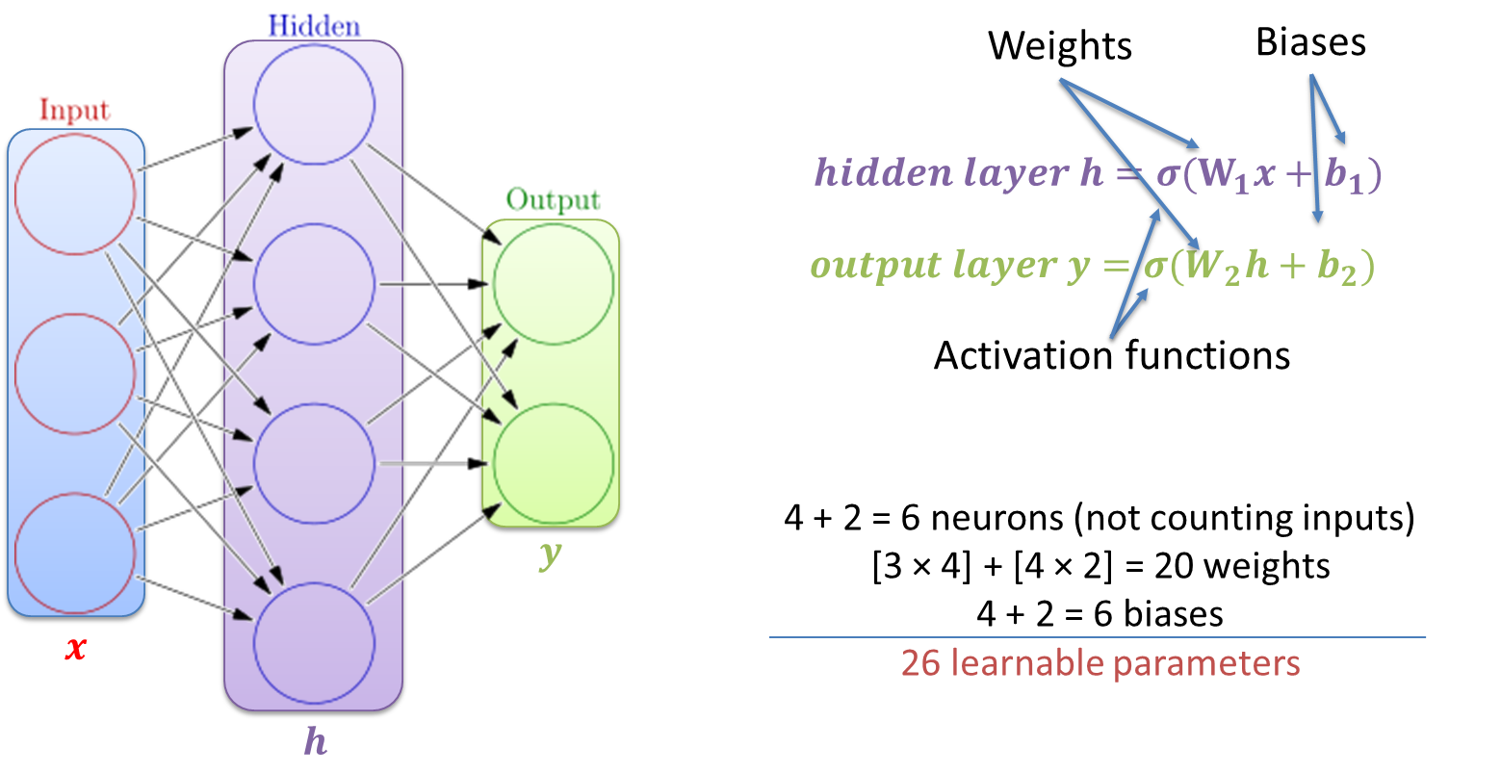
Elements of Neural Networks
A NN with one hidden layer and one output layer

Slide 5
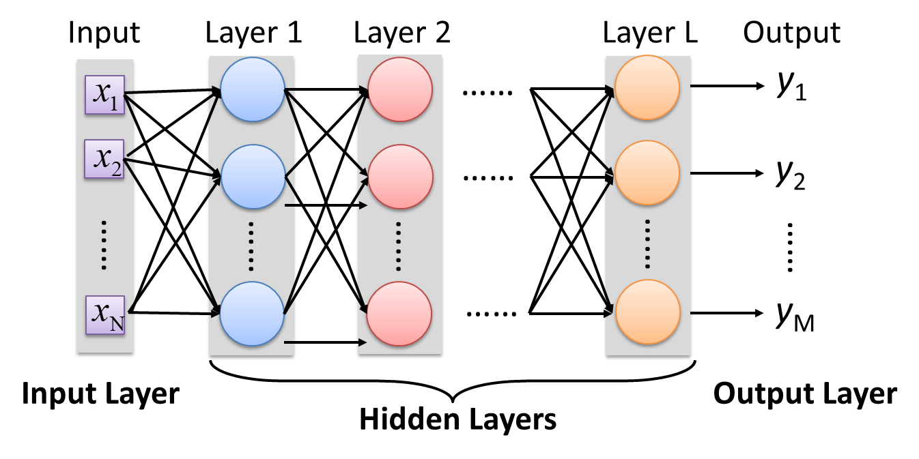
Elements of Neural Networks
Deep NNs have many hidden layers
Fully-connected (dense) layers (a.k.a. Multi-Layer Perceptron or MLP)
Each neuron is connected to all neurons in the succeeding layer

Slide 6
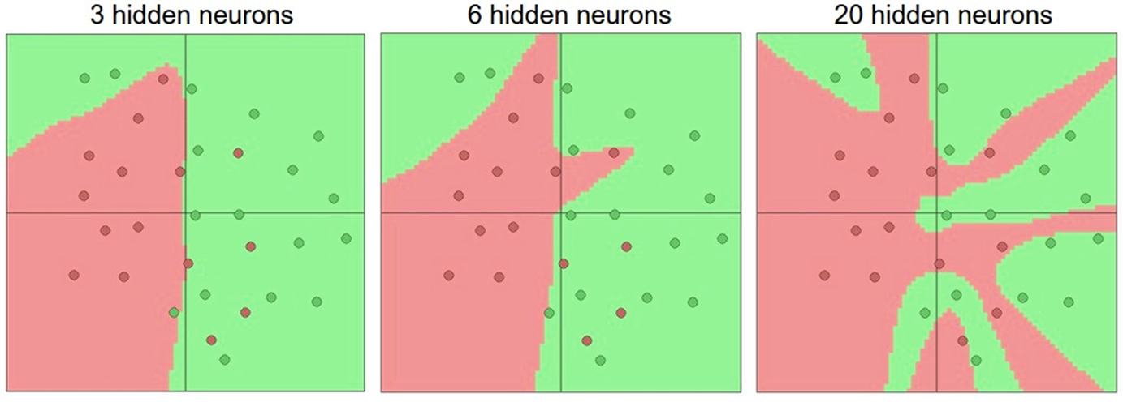
Activation Functions
Non-linear activations are needed to learn complex (non-linear) data representations
Otherwise, NNs would be just a linear function (such as W_1 W_2 𝑥=𝑊𝑥)
NNs with large number of layers (and neurons) can approximate more complex functions
Figure: more neurons improve representation (but, may overfit)

Slide 7
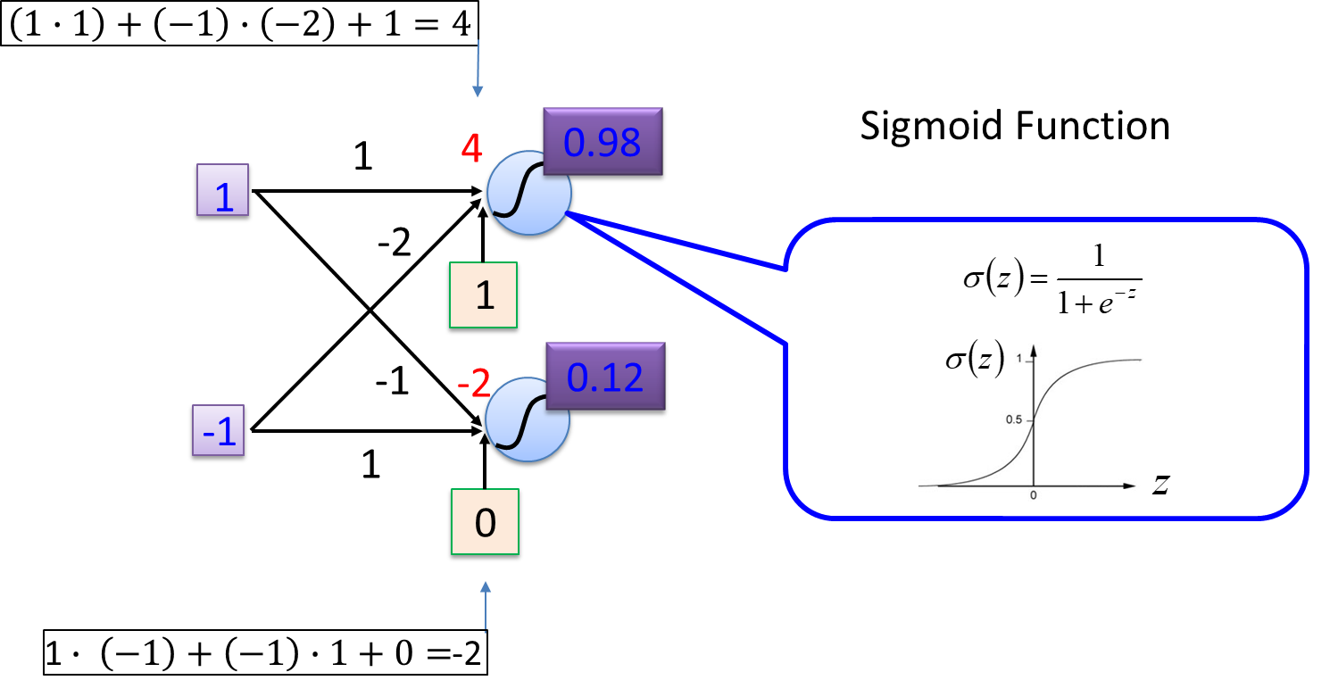
Elements of Neural Networks
A simple network, toy example

Slide 8
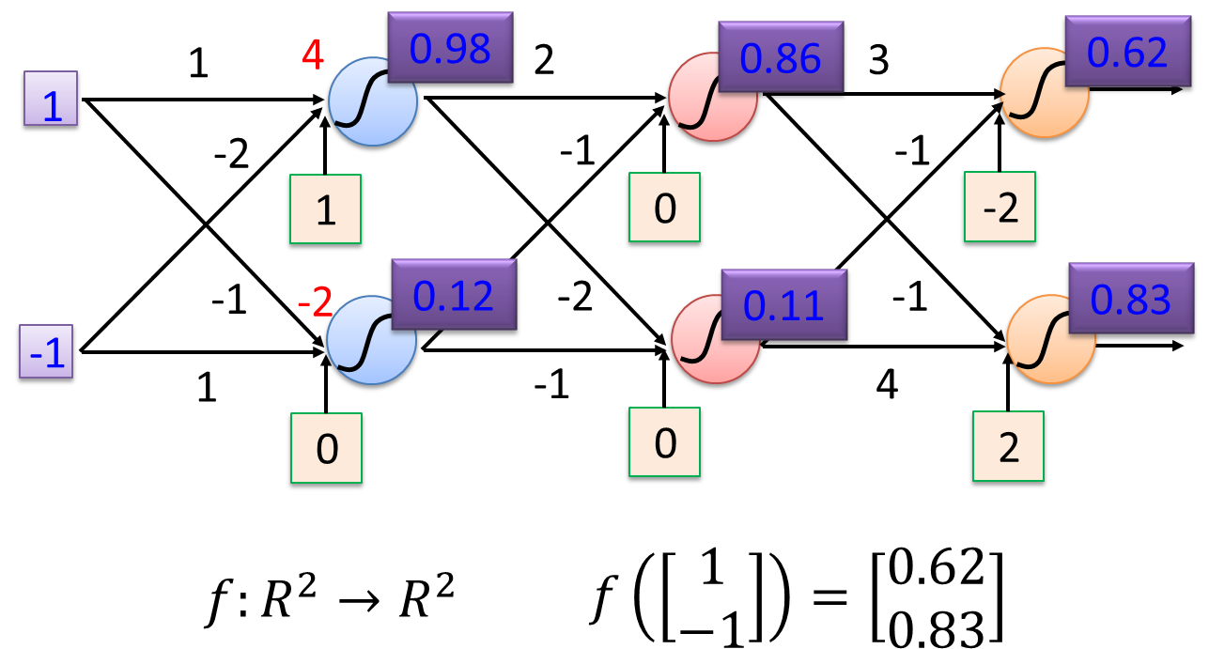
Elements of Neural Networks
A simple network, toy example (cont’d)
For an input vector [1−1)]^{𝑇}, the output is [0.62 0.83]^{𝑇}

Slide 9
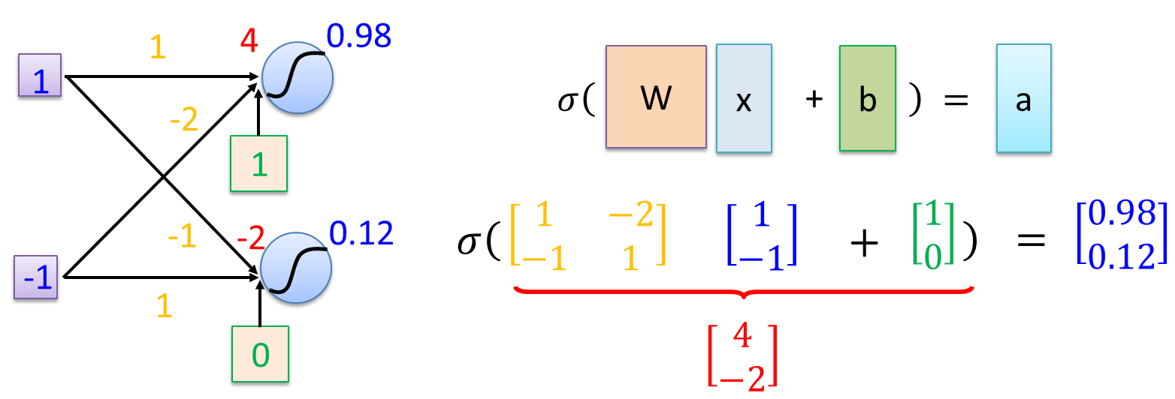
Matrix Operation
Matrix operations are helpful when working with multidimensional inputs and outputs

Slide 10
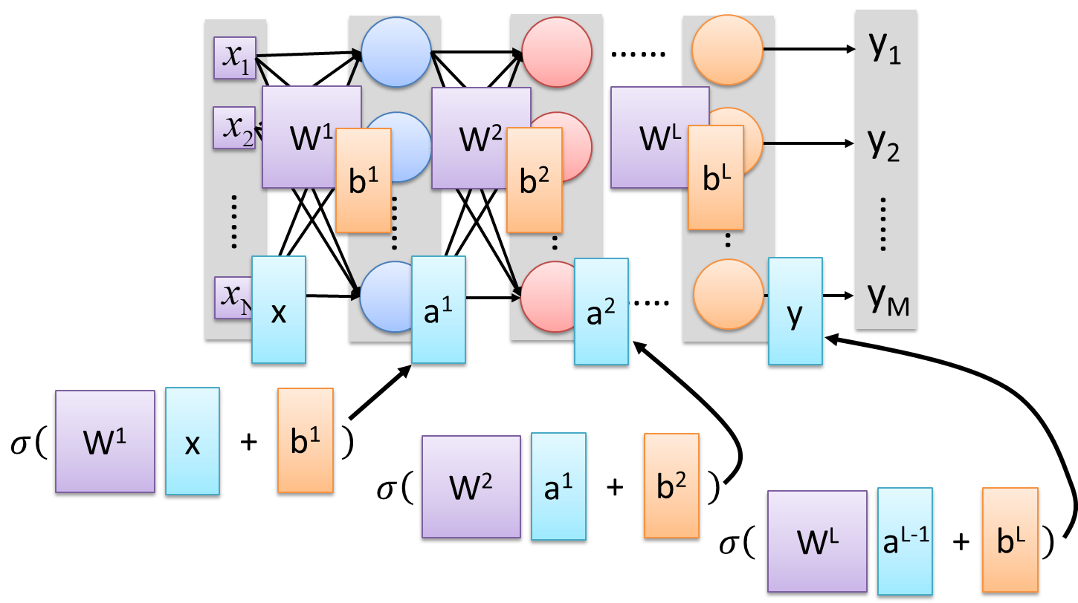
Matrix Operation
Multilayer NN, matrix calculations for all layers

Slide 11
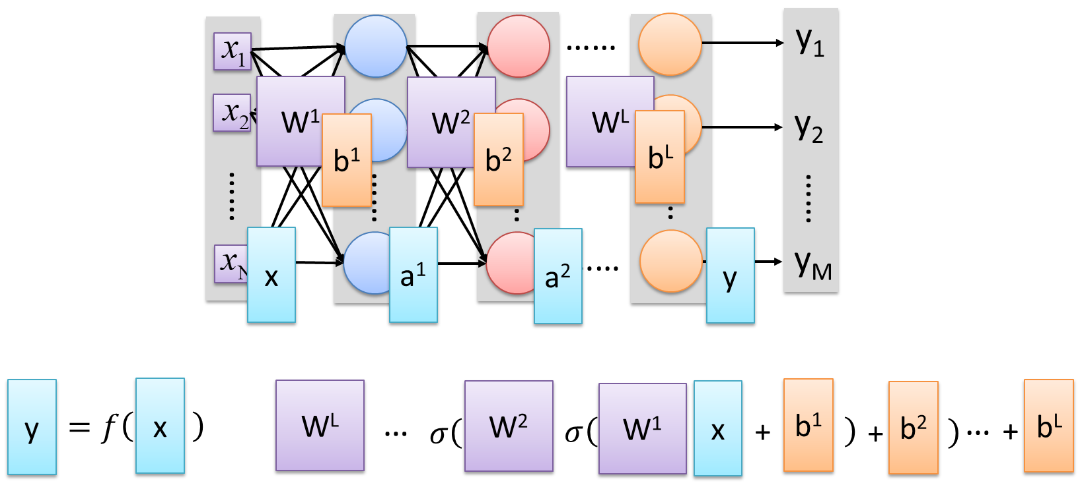
Matrix Operation
Multilayer NN, function f maps inputs x to outputs y, i.e., 𝑦=𝑓(𝑥)

Slide 12
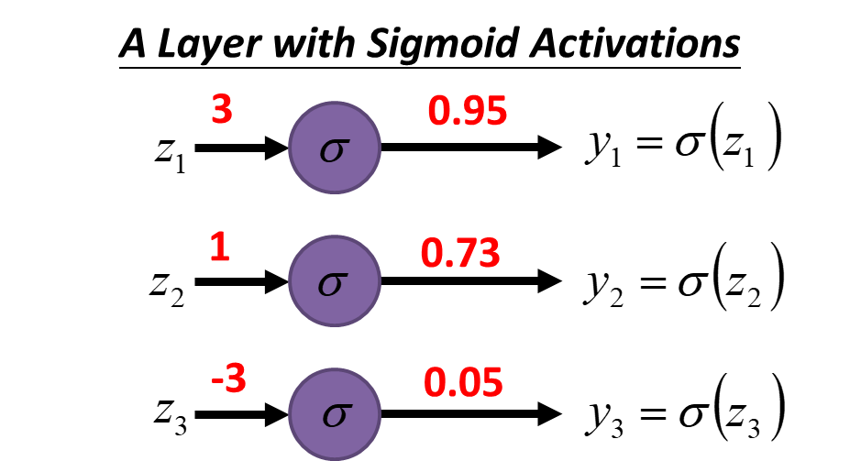
Softmax Layer
In multi-class classification tasks, the output layer is typically a softmax layer
i.e., it employs a softmax activation function
If a layer with a sigmoid activation function is used as the output layer instead, the predictions by the NN may not be easy to interpret
Note that an output layer with sigmoid activations can still be used for binary classification

Slide 13
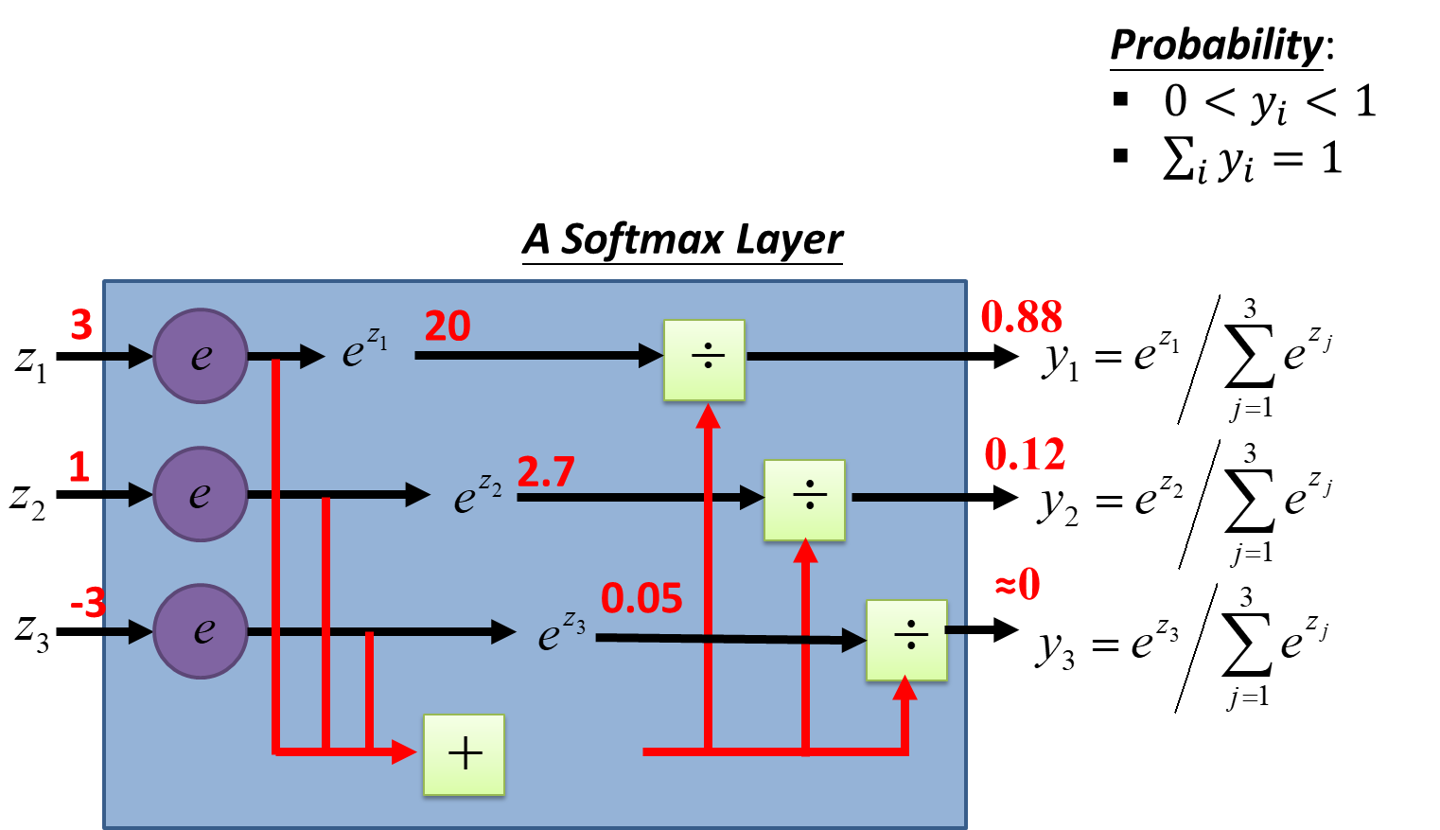
Softmax Layer
The softmax layer applies softmax activations to output a probability value in the range [0, 1]
The values z inputted to the softmax layer are referred to as logits

Slide 14
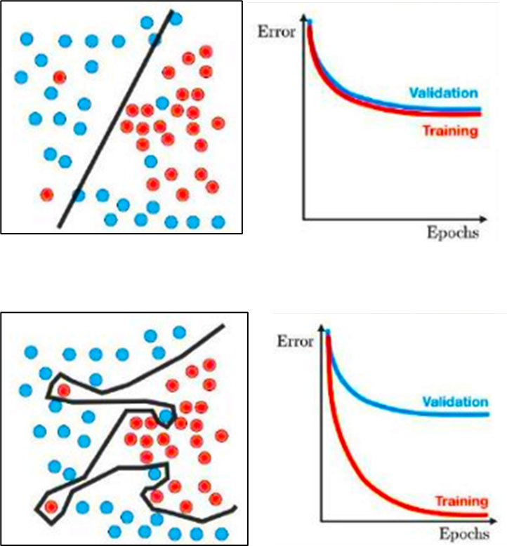
Generalization
Underfitting
The model is too “simple” to represent all the relevant class characteristics
E.g., model with too few parameters
Produces high error on the training set and high error on the validation set
Overfitting
The model is too “complex” and fits irrelevant characteristics (noise) in the data
E.g., model with too many parameters
Produces low error on the training error and high error on the validation set

